Slide 1


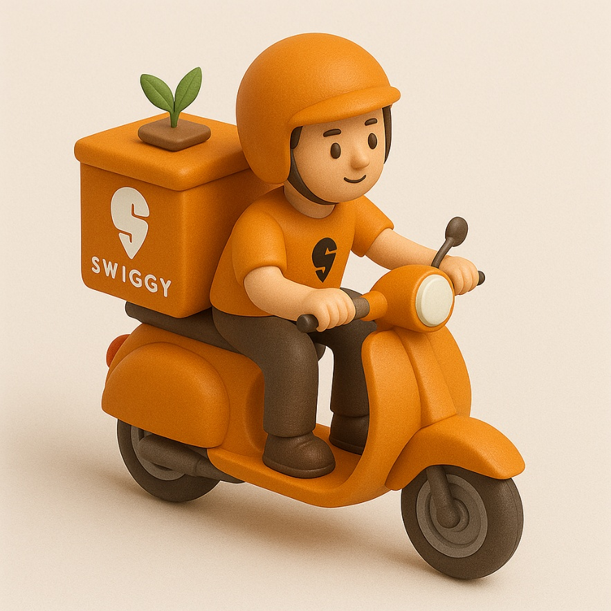



SQL Analysis
Presented By:
Gourav Mohanty

Slide 2



Overview
This project presents a MySQL-based analysis of Swiggy, a top food delivery platform in India. It examines data on customers, restaurants, orders, delivery partners, and ratings to show how SQL supports data-driven decisions. It is ideal for stakeholders, the project highlights how SQL can be used for business intelligence, performance tracking, and operational improvement in the food tech industry.

Slide 3



Agenda
Customer Behaviour Analysis
Delivery Partner & Order Trends
Order Timeline
Restaurant Performance Metrics
Location Based Analysis

Slide 4




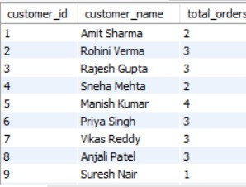
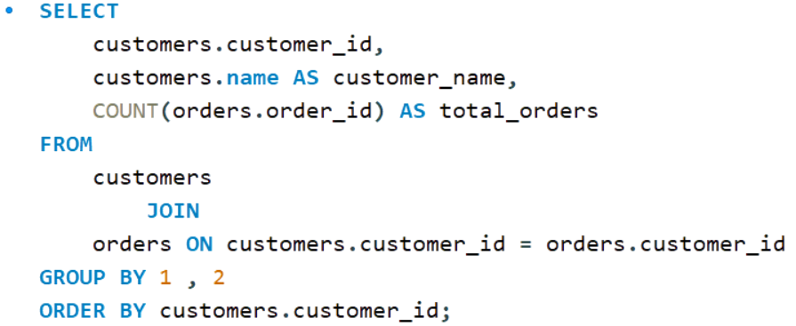





Task 01
Customer Based Analy sis
Customers who have placed at least one order
Query
Outp ut

Slide 5

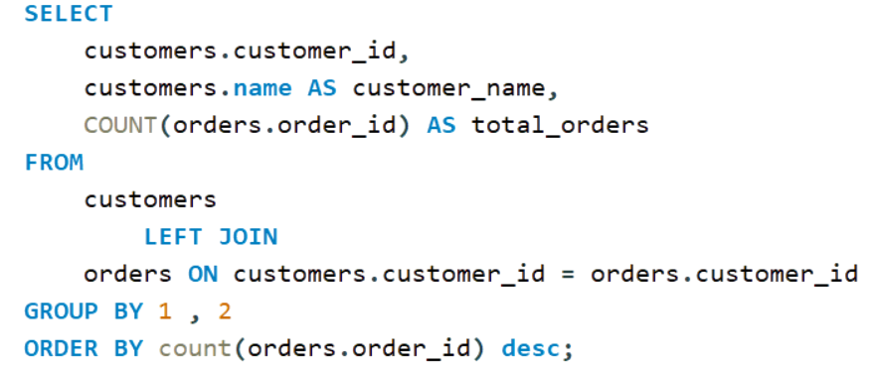
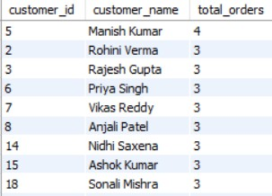
Task 02
Customer Based Analysis
Total number of orders placed by each customer
Query
Output

Slide 6


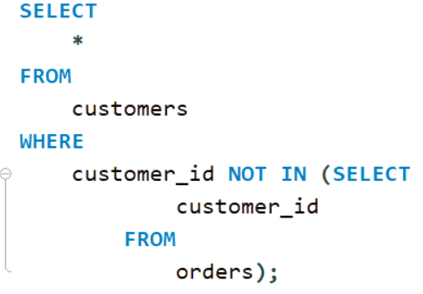
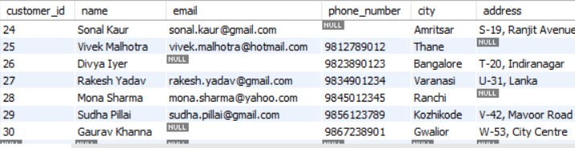
Task 03
Customer Based Analysis
Customers who have never placed an order
Query
Output

Slide 7



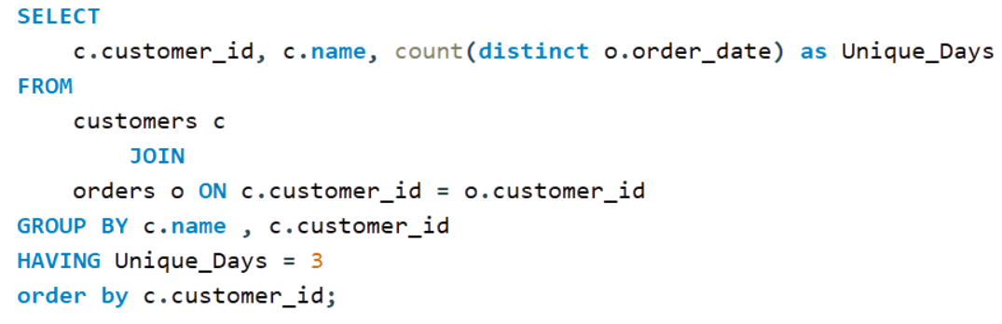

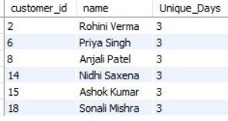
Task 04
Customer Based Analysis
Customers who have placed orders on exactly 03 different days
Query
Outp ut

Slide 8


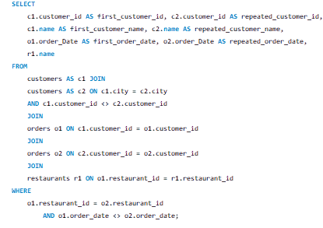

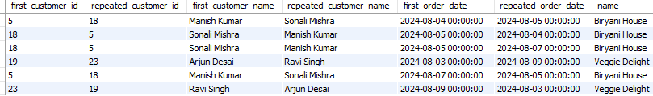
Task 05
Customer Based Analysis
Customers who have same city and have placed orders at the same restaurants, but on different dates
Output
Query

Slide 9

Observations and Suggestions
OBSERVATIONS | SUGGESTIONS
A majority of customers have placed at least one order. | Launch retention campaigns to boost order frequency among active users.
Order frequency differs significantly across customers. | Introduce tiered loyalty programs to incentivize frequent ordering.
Some customers have never placed an order. | Engage these users through personalized onboarding and targeted offers.
Certain users place orders on exactly three unique days. | Analyze behavioral patterns within this group to test timing-based engagement strategies.
Customers from the same city order from the same restaurants on different dates. | Encourage group ordering, referral programs, or social nudges like “Your friend ordered here.”

Slide 10




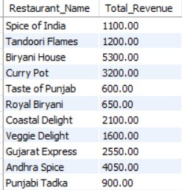
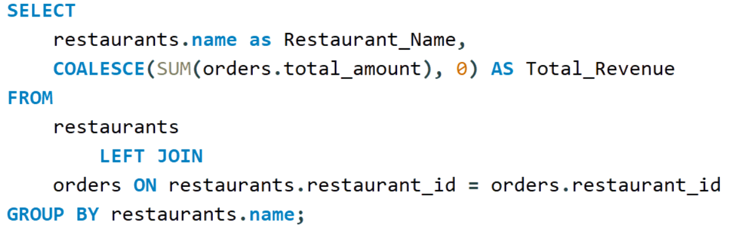
Task 06
Restaurant Performance Metrics
Total revenue generated by each restaurant
Query
Output

Slide 11

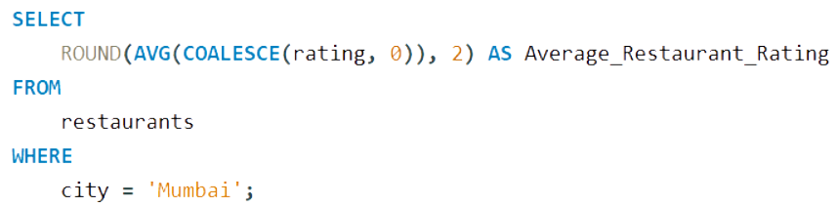

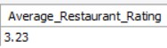
Task 07
Restaurant Performance Metrics
Average rating of all restaurants in 'Mumbai'.
Query
Output

Slide 12



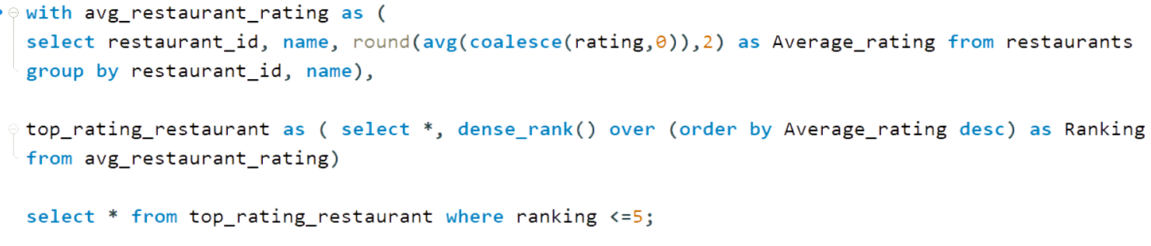
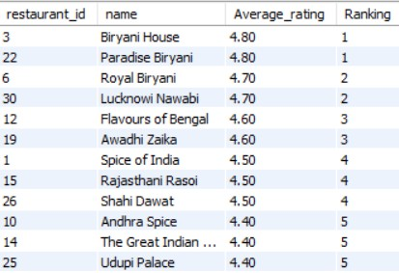
Task 08
Restaurant Performance Metrics
Top 5 restaurants with the highest average rating
Query
Output

Slide 13
Observations and Suggestions
OBSERVATIONS | SUGGESTIONS
Mumbai restaurants show varied average ratings. | Promote top-rated restaurants; audit and improve those with poor ratings through feedback mechanisms or quality checks.
Some restaurants earn significantly higher revenue than others. | Prioritize visibility for high-performing restaurants. Investigate causes behind low revenue in others and take corrective action.
Top 5 restaurants (by rating) clearly stand out. | Feature them in “Editor’s Pick” or boost their presence during peak hours to maximize impact.

Slide 14
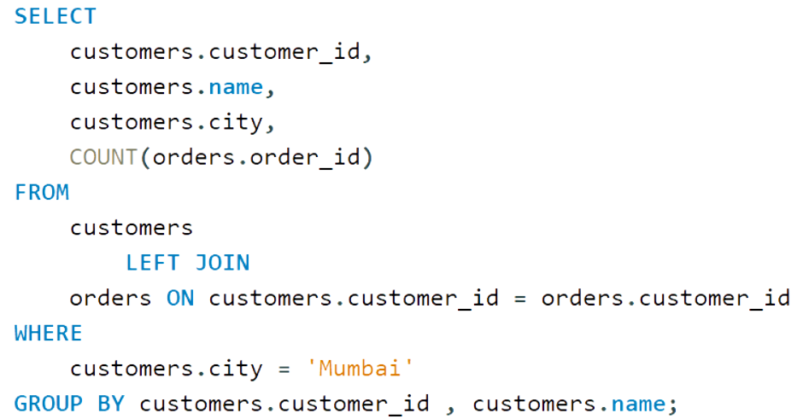

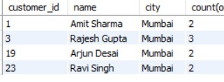
Task 09
Location Based Analysis
Total orders placed by each customer in 'Mumbai'.
Query
Output

Slide 15
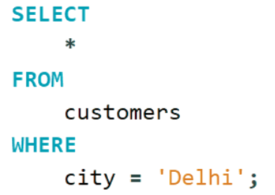

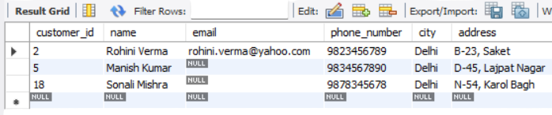
Task 10
Location Based Analysis
Display all customers who live in 'Delhi'.
Query
Output

Slide 16
Observations and Suggestions
OBSERVATIONS | SUGGESTIONS
Active user base is present in Delhi. | Launch localized marketing campaigns and events tailored to the Delhi audience.
Mumbai customers show diverse ordering frequency. | Customize offers and incentives based on customer activity tiers (high/medium/low frequency).

Slide 17
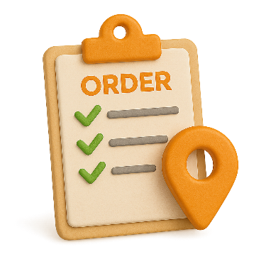

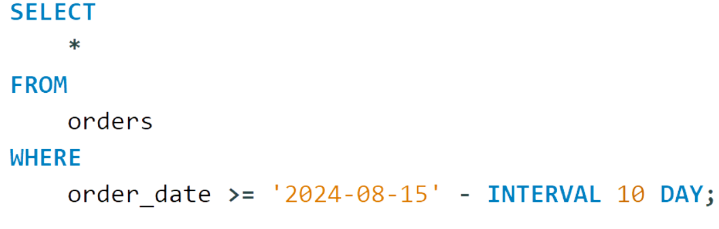
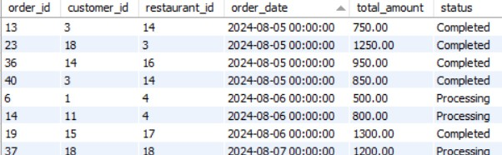
Task 11
Order Timeline
All orders placed in the last 10 days.
Query
Output

Slide 18
Observations and Suggestions
OBSERVATIONS | SUGGESTIONS
Orders have been placed in the last 10 days. | Monitor peak traffic hours using time-based order analysis. Optimize delivery logistics by allocating more riders. during peak hours. Launch flash deals during high-traffic periods to increase conversion Implement personalized push notifications to re-engage recent customers Analyze order patterns to forecast inventory needs more accurately Introduce time-bound discounts to create urgency and drive more orders

Slide 19

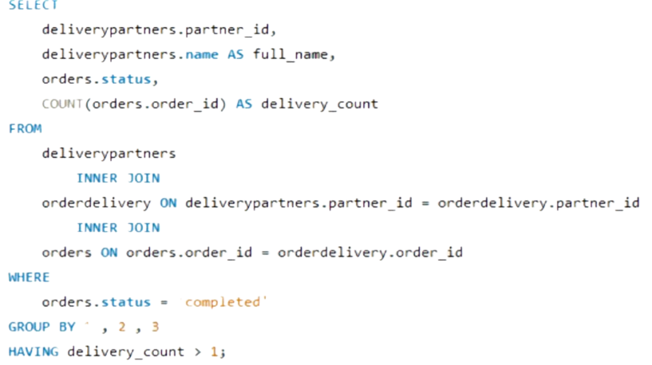

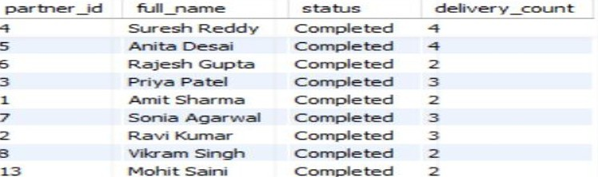
Task 12
Delivery Partners and Order Trends
Delivery Partners Who Have Completed More than 01 Completed Delivery
Query
Output

Slide 20
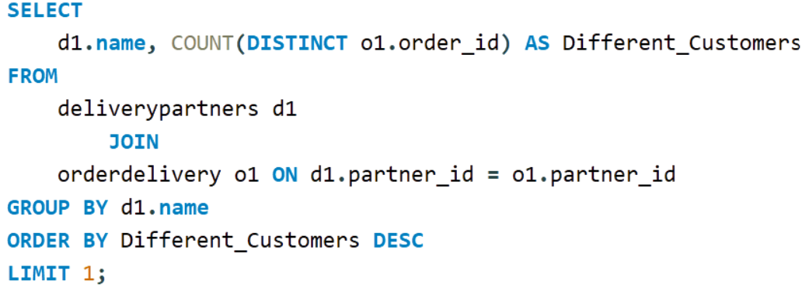
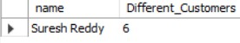
Task 13
Delivery Partners and Order Trends
Delivery Partner who has worked with the most different customers
Query
Output

Slide 21
Observations and Suggestions
OBSERVATIONS | SUGGESTIONS
Some delivery partners have multiple successful deliveries. | Implement a tiered incentive program for top- performing partners. Use their delivery data to train or mentor new hires.
A few partners serve more unique customers. | Analyze their delivery areas to identify underserved zones. Use them for pilot testing hyperlocal delivery campaigns.

Slide 22




Thank
You !

